Slide 1
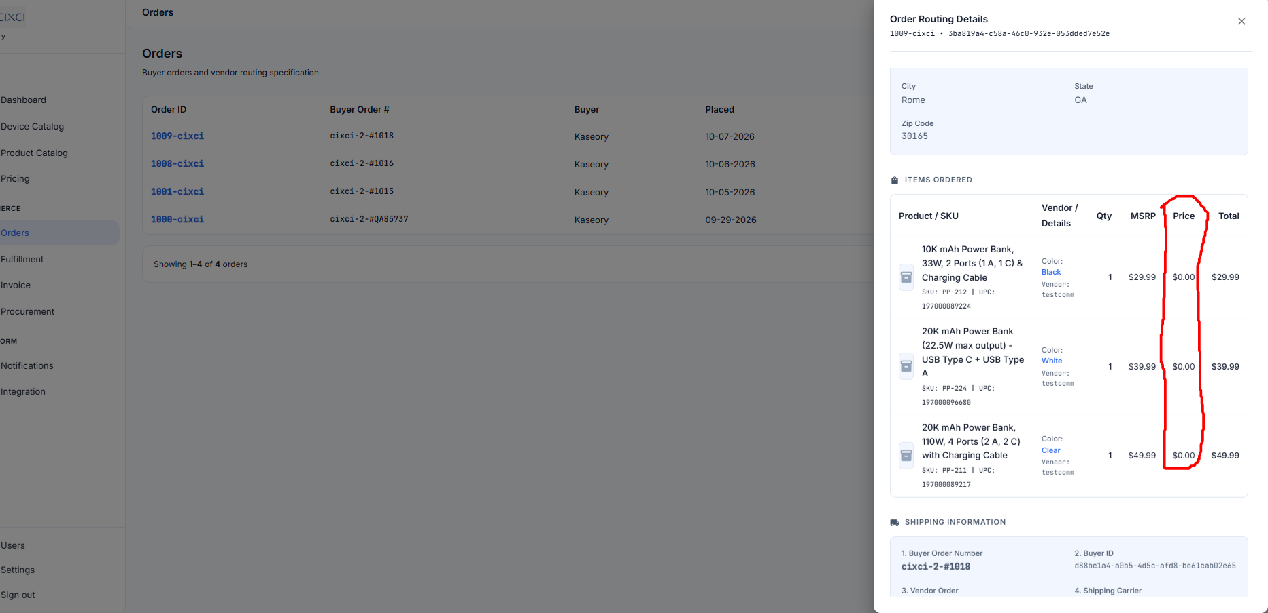
On the “Order Routing Details” section for the Buyer admin and CIXCI admin the “Price” column should be “Wholesale Price” and show the wholesale price.

Slide 2
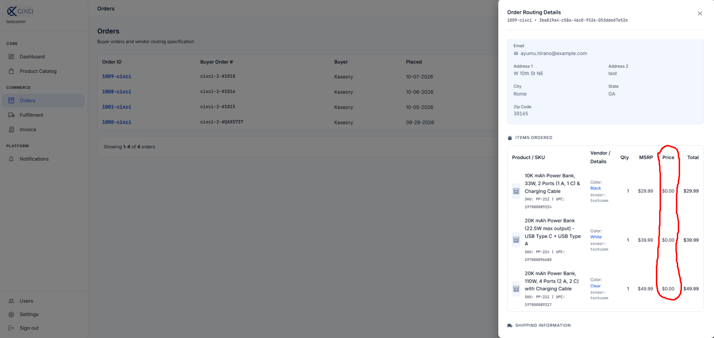
On the “Order Routing Details” section for the vendor admin the “Price” column should be “Vendor Wholesale Price” and show the vendor wholesale price

Slide 3
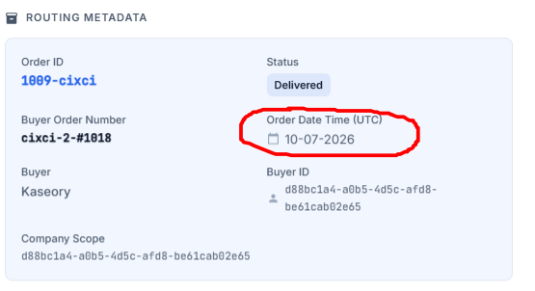
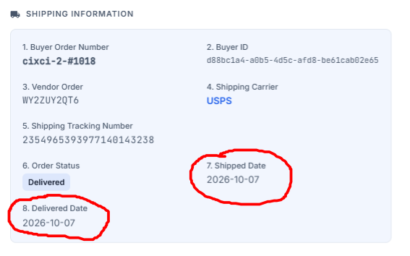
The date format throughout the platform should be MM-DD-YYYY
Correct date format
Incorrect date format

Slide 4
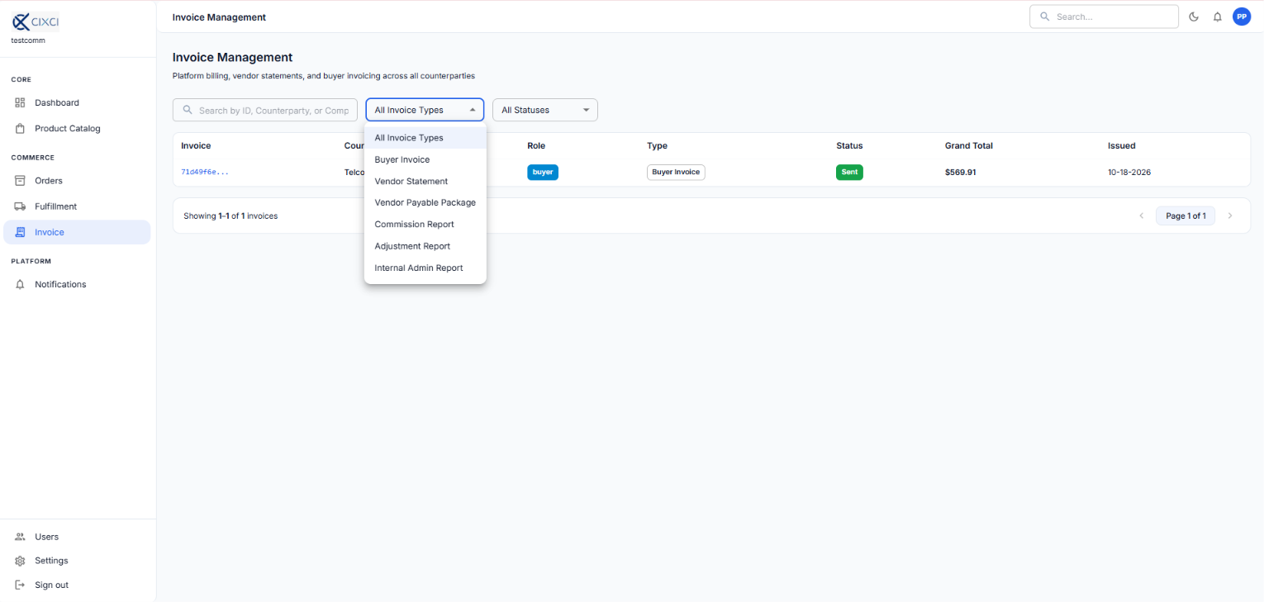
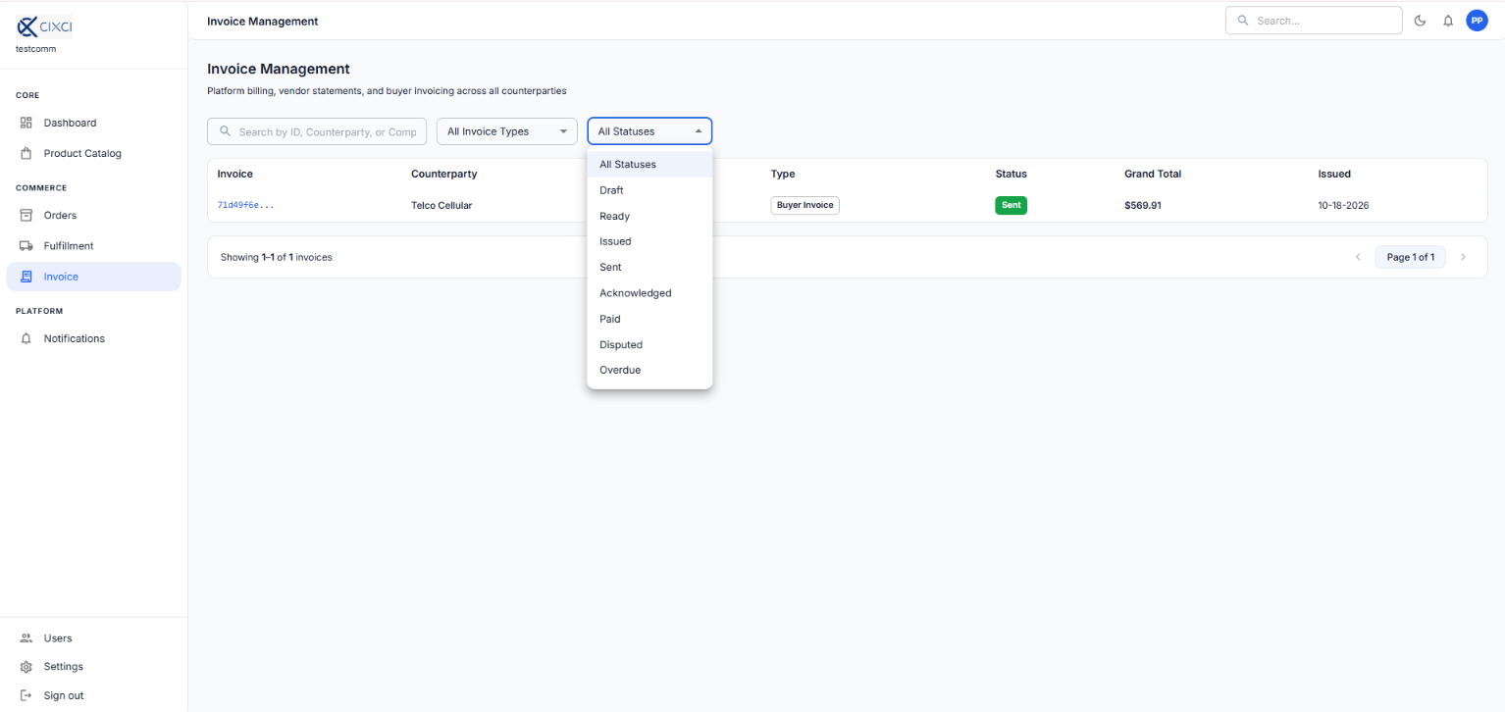
In the invoice module, users should see only “Invoice types” and “All Statuses” that are associated to the user type.
Buyer should see only their invoices.
Vendor should not be able to see buyer invoices.

Slide 5
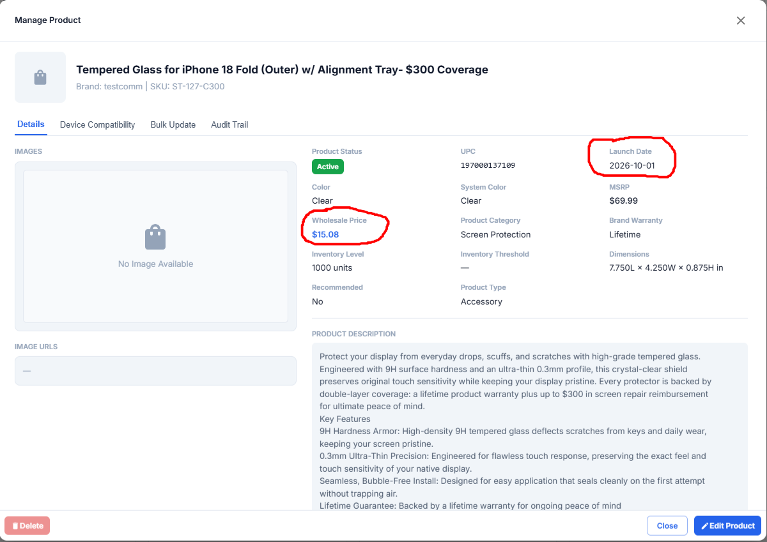
The vendor admin should only see the “Vendor Wholesale Price” not “Wholesale Price”
The Launch Date needs to follow the MM-DD-YYYY

Slide 6
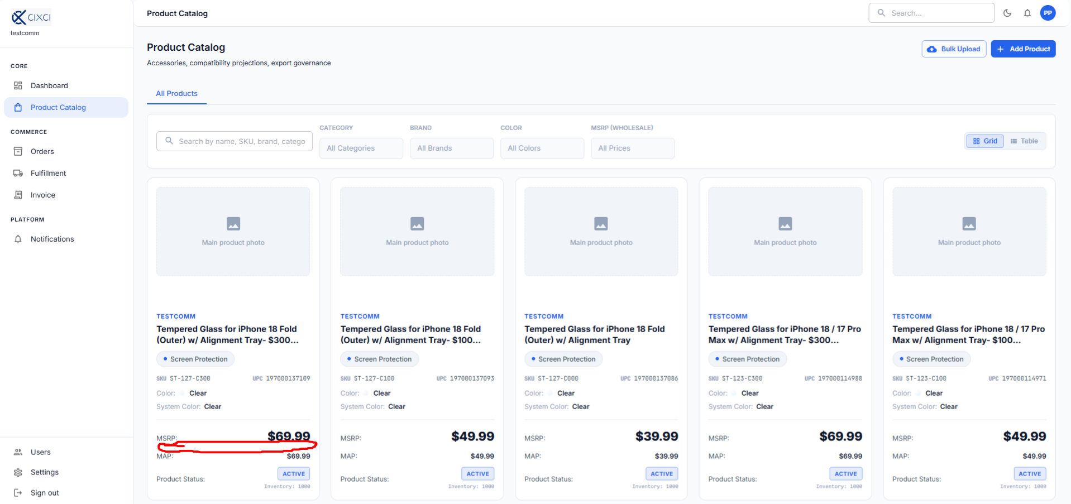
The “Vendor Wholesale Price” is missing for the Vendor admin.

Slide 7
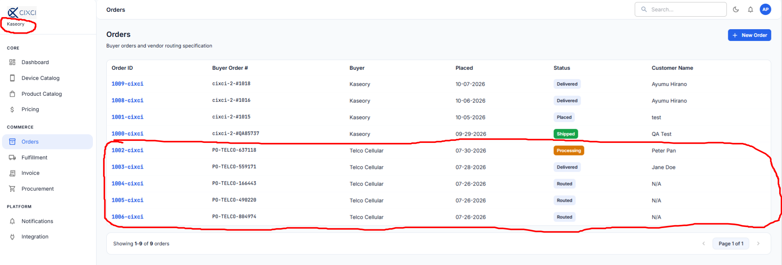
Buyers should only see their orders

Slide 8
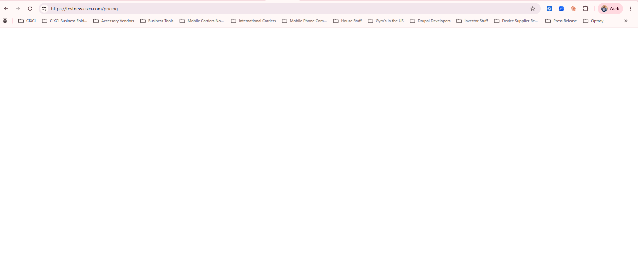
When logged in as a buyer (Kaseory) and I click on “Pricing” I get a white screen.

